Slide 1


Parsons problem generator and solver
P1908345 Jane
1

Slide 2

Introduction
Contents
Background
Objectives
Tasks
Prototype Demo
Parsons Problem Analysis
Future Work
Conclusion
2

Slide 3


Introduction
Parsons problem is a type of programming exercise where students rearrange the jumbled code blocks of a solution program back into its original form by dragging and dropping these code blocks.
In the introductory CS course, Parsons problem provides students notable assistance in programming study:
Provide a preparation stage before writing code directly
Reduce students' cognitive load
Improve students' engagement
3

Slide 4


Problem
Most of Parsons problem is only used for programming exercises in introductory programming course (CS1) and not in higher-level programming courses such as Data Structures and Algorithms (CS2)
Use Parsons problem in CS2
Challenging work for exercises in CS2 Need Parsons problem to prepare students for writing code by themselves
Background
Just change input exercise?
Since there are plenty of differences between the exercises in CS1 and CS2, it is not so proper to apply Parsons problem directly in CS2 without tailored improvement.
4

Slide 5


Input CS2 Questions & Solutions (Python)
Give Feedbacks
Website
Objectives
Generate Parsons Problem
Show Jumbled Codes & 2D Place for Arranging Codes
Drag and Drop Codes
5

Slide 6


A prototype for the traditional Parsons problem (CS1)
Completed
Tasks
Uncompleted
Develop the specific functions for CS2
Analysis about using Parsons problem in CS2
6

Slide 7

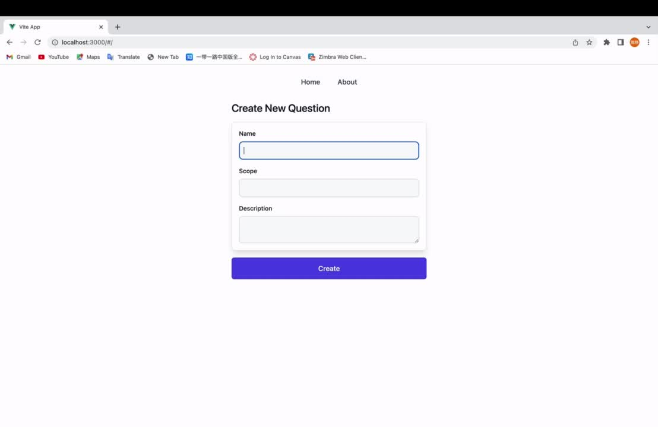

Prototype Demo
7

Slide 8

Object Oriented Programming
Parsons Problem Analysis
(CS2)
Data Structures Implementation Comparison and Algorithms Comparison
Algorithm Analysis
Recursion
8

Slide 9
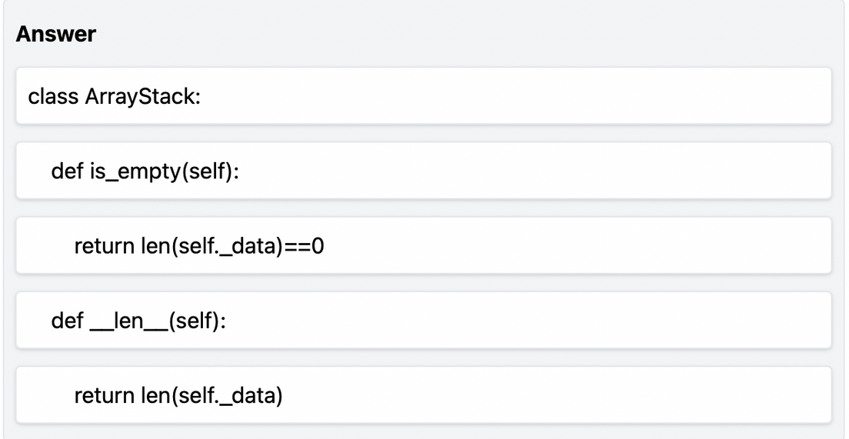

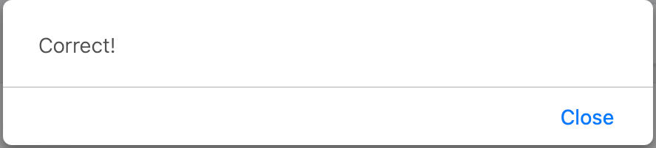
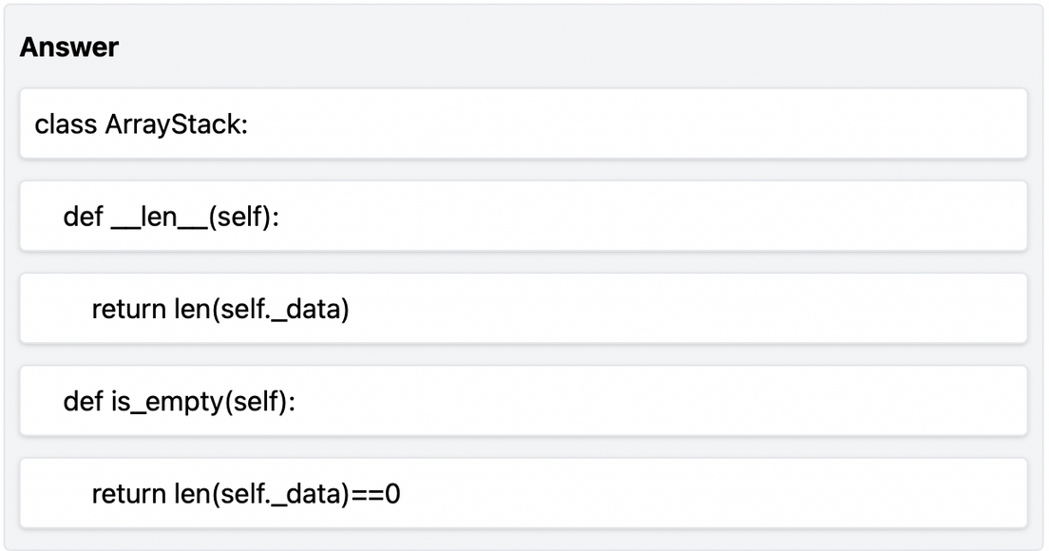
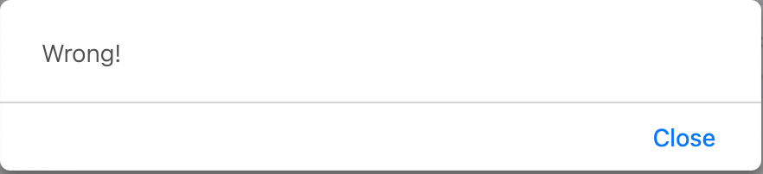
Object Oriented Programming
It is common to use object-oriented programming to show different data structures in CS2.
In this type of question, if we directly use the traditional Parsons problem, we may get multiple correct answers, which contradicts one of the properties of Parsons problem -only allowing a unique correct answer.
9

Slide 10

Object Oriented Programming
class ArrayStack:
Solution #1
Give a fixed order of method descriptions, and let students rearrange methods in a matching order.
def __len__(self):
Return the number of element in stack S
return len(self._data)
def is_empty(self):
Return True if stack S does not contain any element
return len(self._data) == 0
10

Slide 11

Object Oriented Programming
class ArrayStack:
Solution #2
Cut the whole solution into small units (methods), and check the contents in every unit separately.
def is_empty(self):
return len(self._data) == 0
def __len__(self):
return len(self._data)
11

Slide 12
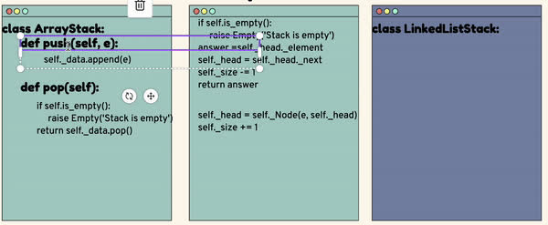
Data Structures Implementation
Comparison
12

Slide 13
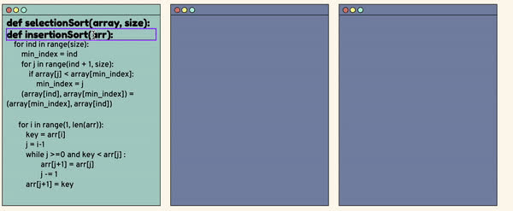
Algorithms Comparison
13

Slide 14
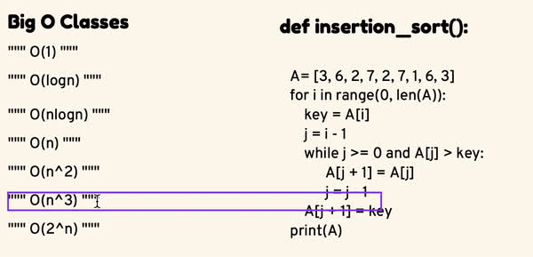
Algorithm Analysis
14

Slide 15
Recursion
def TowerOfHanoi (n, source, destination, auxiliary):
The traditional Parsons problem reduces difficulty by providing some code fragments for students to read.
However, in the recursion type of question, it is arduous to understand the meaning of every line of code even if the whole code is given in order
if n == 1:
print("Move disk 1 from source", source, "to destination", destination)
return
TowerOfHanoi(n-1, source, auxiliary, destination)
print("Move disk", n, " from source", source, "to destination", destination)
TowerOfHanoi(n-1, auxiliary, destination, source)
15

Slide 16
Recursion
# step 3: choose correct method headers with proper signiture
# step 1: base case
def fib1():
return 1
def fib2():
return 1
# fib(n-1)+fib(n-2)
# fib(n)+fib(n-1)
# step 2: other subproblem
# step 4: reorder actual recursion codes
def fib3():
return fib1()+fib2()
def fib4():
return fib2()+fib3()
def fib(n):
if n == 1 or n == 2
return 1
return fib(n-1)+fib(n-2)
16

Slide 17
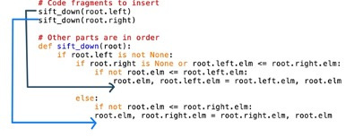
Balance the degree of difficulty
Switch Different Difficulty Levels
Switch more accessible version halfway
Pre-scaffold
Provide structures, steps, or subgoals
Context
Fix most of codes as context and only insert the key code fragments
17

Slide 18


Future work
Achieve the function mentioned before
Implement the function of inputting and showing multiple solutions
Implement the function of altering the difficulty level
Implement the function of handling comments, pseudocodes
18

Slide 19
Conclusion
Prototype of Parsons problem
New ideas about using Parsons problem in CS2
19

Slide 20

Thank you!
20

